Slide 1
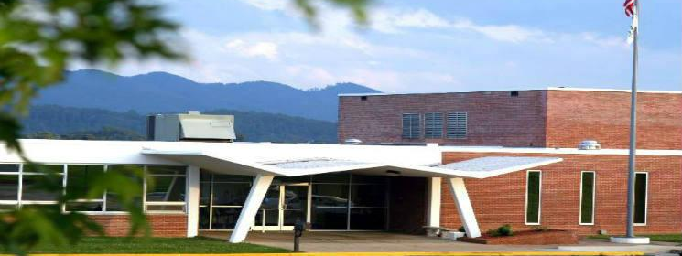
Innovation Lab Project
Team #NoFinal:
Project Manager: Emily Burdick
Dennis Adjei-Baah, Brett Cusaac, Olaniyi Falomo, Matt Harrison, Allison Ivey, Raj Khanal
(introduce the team on this slide) (delete red text in final version)

Slide 2
Topics
Team Responsibilities
Technologies Used
What Went Well
What Needed Improvement
What We Learned
Demo
What We Did Differently
Conclusion

Slide 3
Team Responsibilities
Emily Burdick
Project Manager, Front-end
Dennis Adjei-Baah
Front-end Lead, Git
Brett Cusaac
Back-end Lead, RESTful API
Olaniyi Falomo
Back-end, reporting, ETL
Matt Harrison
Back-end, documentation
Allison Ivey
Back-end, Front-end, documentation
Raj Khanal
Front-end, reporting

Slide 4






Technologies Used
Back-end:
DBMS: MySQL
RESTful API in PHP
Front-end:
Reporting / CRUD: Angular
Excel PivotTable
Other:
Diagramming: LucidChart
Version control: Bitbucket
Project management: Taiga.io
Team communication: Slack

Slide 5
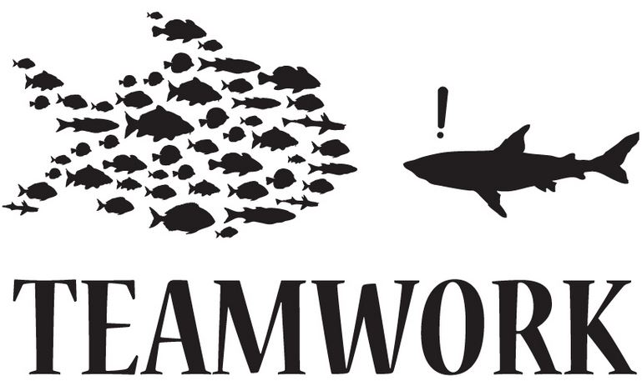
What Went Well
Team communication:
Weekly meetings / stand-ups
Constant communication through Slack
Willingness to debate and compromise
Team participation:
Functional teams for front-end, back-end
Pair programming as needed
Active leadership: educators and managers
All team members contributed

Slide 6
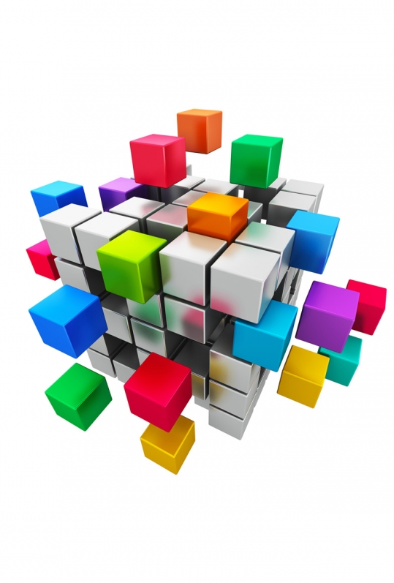
What Went Well
Development process:
Met with clients and clarified design
Gathered and researched additional information
Followed database life cycle
Taiga.io helped organize tasks
Opportunity to learn new technologies
Final product:
Back-end technology works well: MySQL, RESTful API
Front-end: clean design, dynamic, looks nice

Slide 7
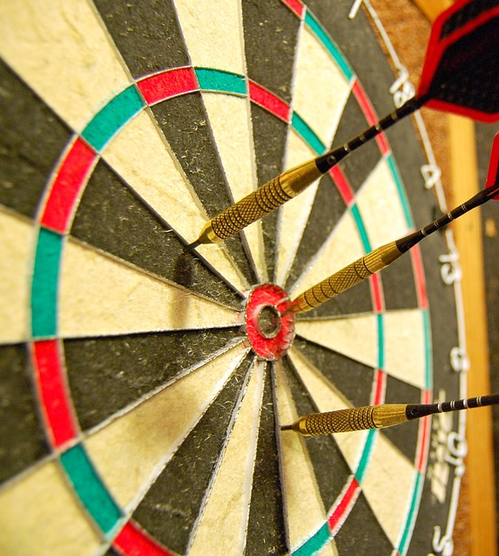
What Needed Improvement
Time constraints:
Finding time for full team to meet
Everyone busy: making time to develop system
Additional time for education on technologies
More time to add additional functionality to system
Functional teams limited chances to work with all technologies
Front-end team had little MySQL exposure
Back-end team had few Angular interactions

Slide 8
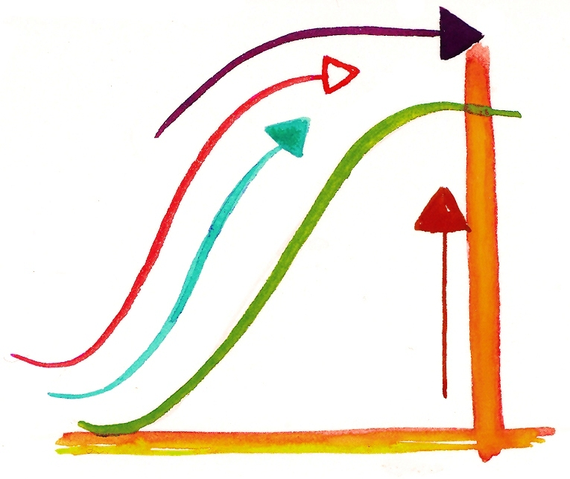
What Needed Improvement
Git learning curve
Angular learning curve
Conceptual
Implementation
Re-evaluate front-end technology stack
Overcomplicated with Node.js, Grunt

Slide 9
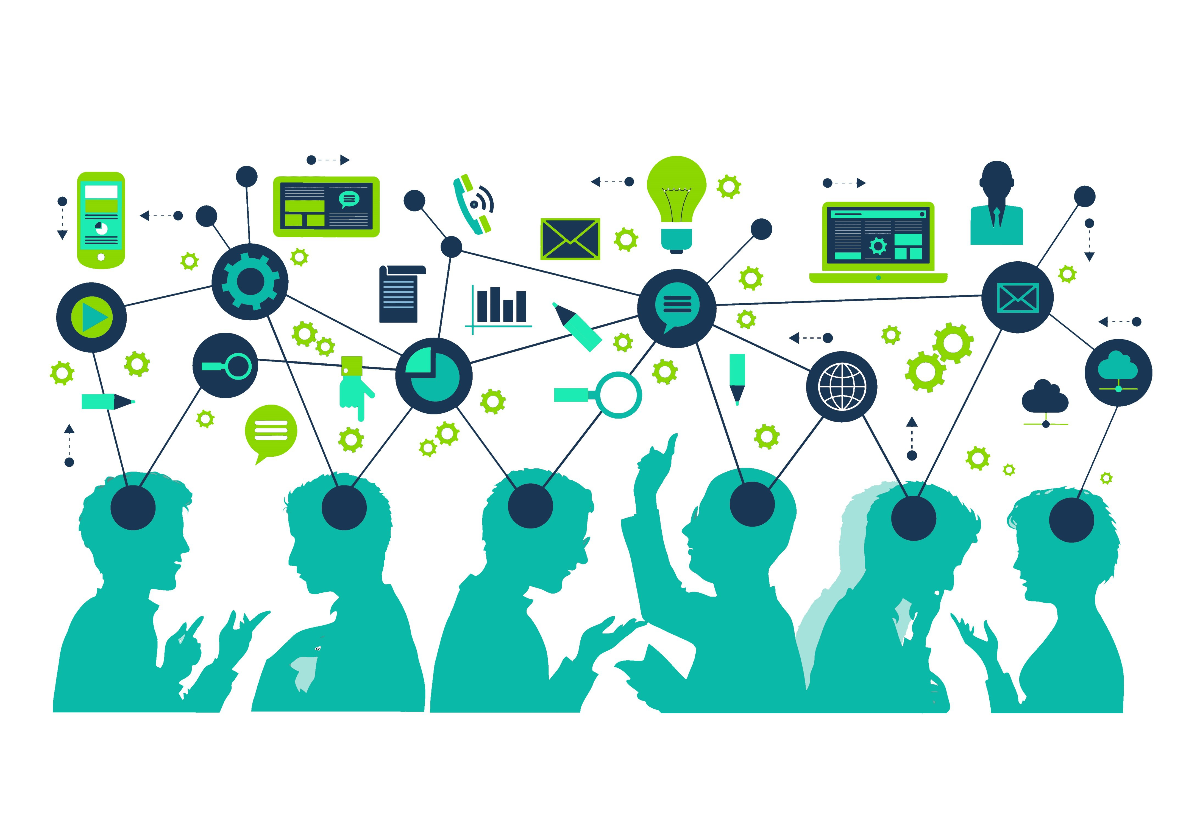
What We Learned
Data-first design
Design and data evolve during implementation
Importance of database design in overall system
Modeling complex relationships
Referrals
Not all relationships binary 1:N
Database life cycle
Refresh helpful for most of team
Difference between conceptual vs implementation

Slide 10
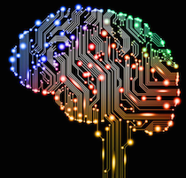
What We Learned
Technologies
Angular / dynamic web development
Git
MySQL
Stored procedures
Teamwork
How to lead, follow
Collaboration tools: Taiga.io, Slack

Slide 11
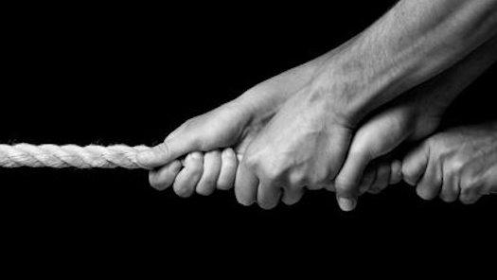
Challenges Overcome
How to correctly model Referrals in a relational database
Modeling individuals and companies – using strong/weak paradigm
Learning new technologies in a short time-frame

Slide 12
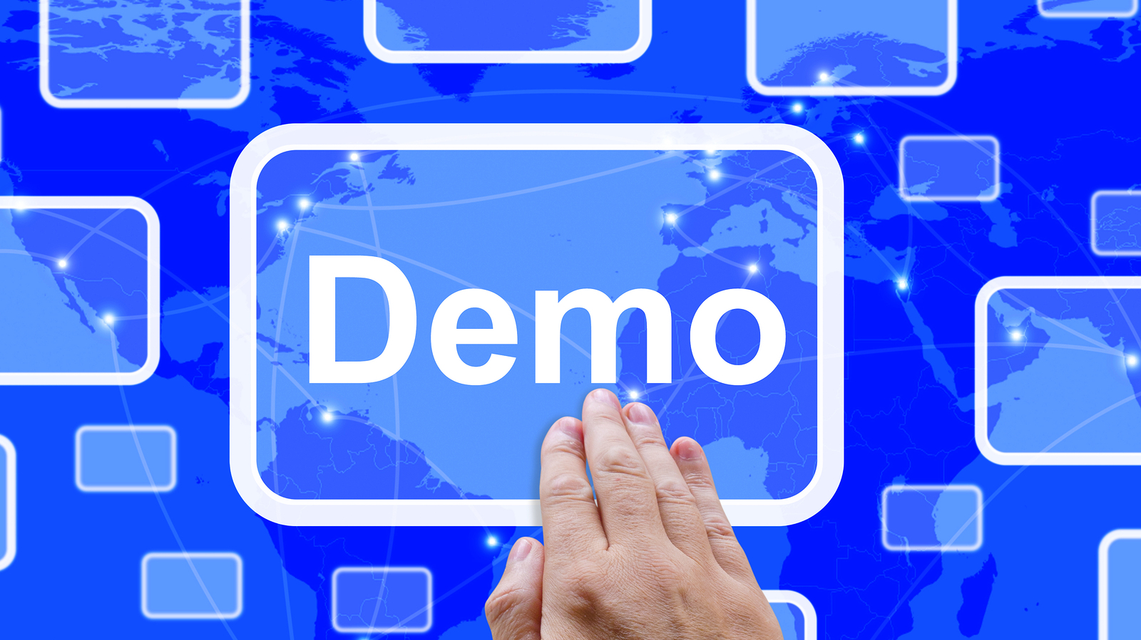

Slide 13

What We Did Differently
Customer survey – separate clients from admin system
Client mentioned security concerns with sensitive data
Group organization
Larger group: need for more formal organization
Functional teams
Data visualization with quick filtering
Dynamic graphs
Met with client outside of in-class presentation
Reviewed design in person
Gathered feedback

Slide 14

Results
Followed database life cycle from conceptual to implementation
Created reporting system in short amount of time
Learned:
New technologies
Data-first design
Working with a larger team
Project went well – few complaints
Team enjoyed working on this project

Slide 15


